Slide 1
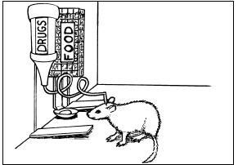
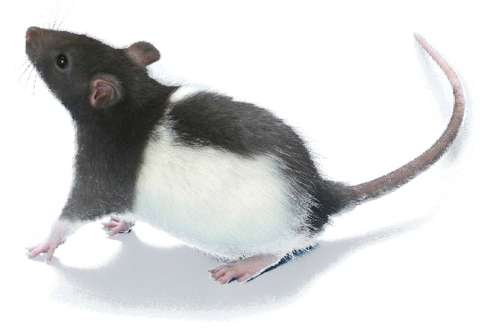
Neurological Disorders Lesson 5.1
What circuit do drugs affect in our brains?

Slide 2
Do Now:
What is drug addiction?
How can scientists figure out what parts of the brain are involved in addiction?

Slide 3
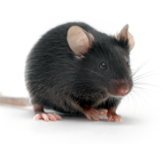
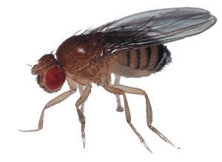
Should animals be used in scientific research?

Slide 4
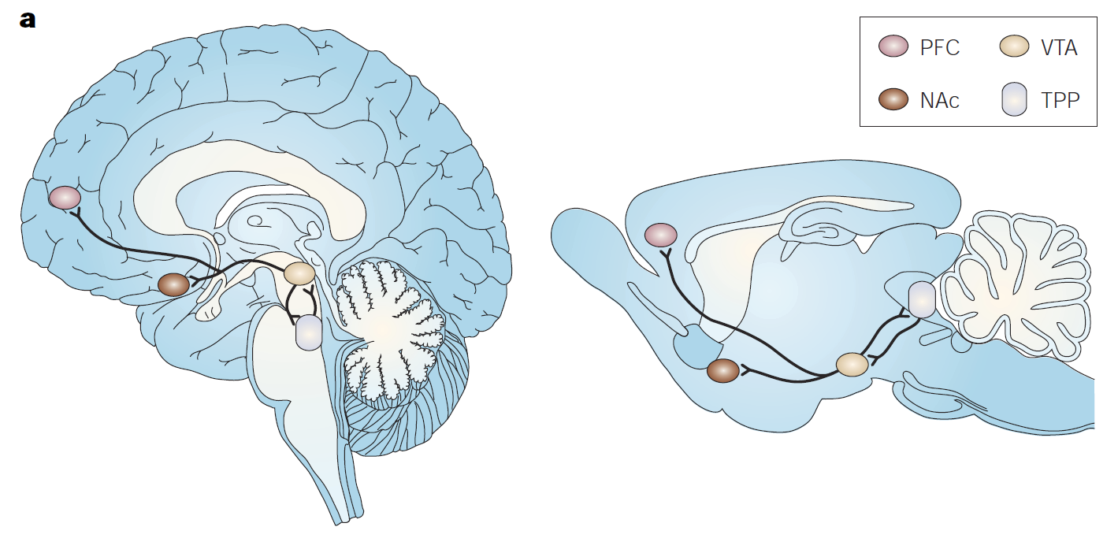
Comparing the Human and Rat Brain
Human Brain
Rat Brain
Both have large cerebellums and differently shaped ventricles (white gaps)
Humans have a more developed cerebral cortex, many gyri and sulci (ridges and grooves)
Lower parts of the brain are almost identical in mice, rats and humans
* This area is what controls addiction

Slide 5
How do scientists figure out what parts of the brain are involved in addiction?
Complete Lab on Paper.

Slide 6
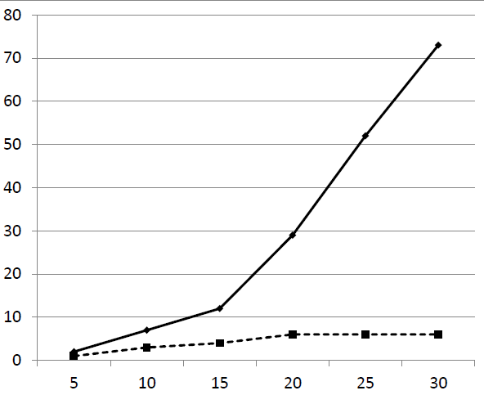
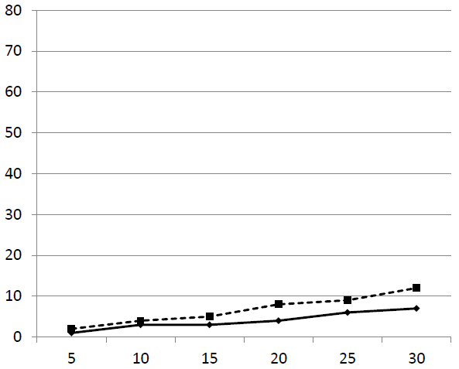
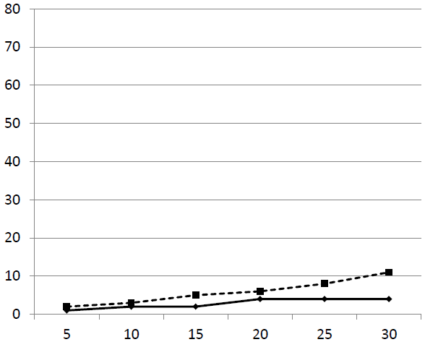
The Data
Which rats pressed the stimulus lever the most?
Which rats pressed the food lever the most?
*
Rat A
Rat B
Stimulus
Food
Total number of lever presses
Total number of lever presses
Time (min)
*
Time (min)
Rat C
Rat D
Total number of lever presses
Total number of lever presses
Time (min)
Time (min)

Slide 7
What parts of the brain are involved in addiction?
*
Rat A
Rat B
cocaine
control
*
Rat C
Rat D

Slide 8
The Brain’s Reward Circuit
Prefrontal Cortex
(PFC)
Nucleus Accumbens
(NAc)
Ventral Tegmental Area
(VTA)

Slide 9
The Brain’s Reward Circuit
Human Brain
Rat Brain
PFC
NAc
VTA

Slide 10
Why do humans abuse drugs?

Slide 11
What is Addiction?
Addiction is the continued compulsive use of drugs in spite of adverse health or social consequences.
The Science of Addiction: Your Brain on Drugs

